Slide 1

Zara Sales Analysis
E-Commerce Industry
- Pratyush Majumdar

Slide 2

Objective
To identify trends and patterns across various product categories, store locations, and sales periods.
The goal is to provide actionable insights that can help optimize marketing strategies, improve inventory management, and enhance overall revenue and profitability.
By understanding customer purchasing behavior and product performance, Zara can make data-driven decisions to strengthen its competitive position in the market.

Slide 3
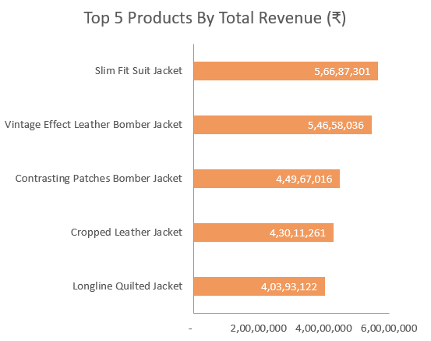
Insights
1) List down the top 5 products with the highest revenue earned which are seasonal.
Top 5 Products By Total Revenue
Slim Fit Suit Jacket
Vintage Effect Leather Bomber Jacket
Contrasting Patches Bomber Jacket
Cropped Leather Jacket
Longline Quilted Jacket

Slide 4
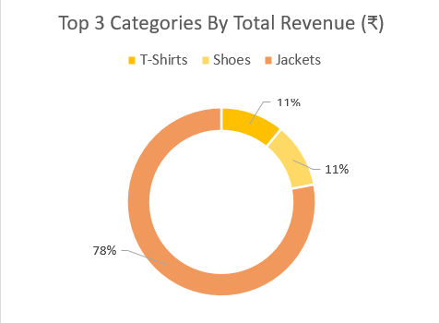
2) List down the top 3 categories with the highest revenue earned for men's section.
Top 3 Categories By Total Revenue
T-Shirts
Jackets
Shoes

Slide 5
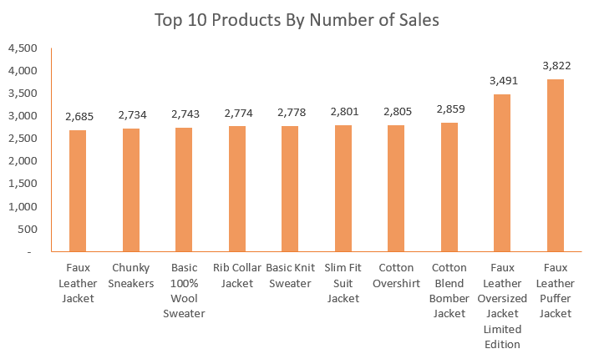
3) List down the top 10 products with the highest number of sales which are located at the front of store.
Top 10 Products By Number of Sales
Faux Leather Jacket
Chunky Sneakers
Basic 100% Wool Sweater
Rib Collar Jacket
Basic Knit Sweater
Slim Fit Suit Jacket
Cotton Overshirt
Cotton Blend Bomber Jacket
Faux Leather Oversized Jacket
Faux Leather Puffer Jacket

Slide 6
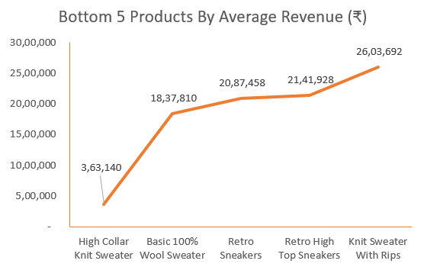
4) List down the bottom 5 products with the lowest average sales which are not promoted.
Bottom 5 Products By Average Revenue
High Collar Knit Sweater
Basic 100% Wool Sweater
Retro Sneakers
Retro High Top Sneakers
Knit Sweater With Rips

Slide 7
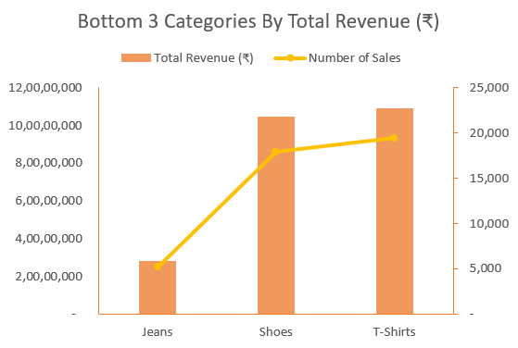
5) List down the bottom 3 categories with the lowest revenue which are located at end-cap and also show number of sales.
Bottom 3 Categories By Total Revenue
Jeans
Shoes
T-Shirts

Slide 8
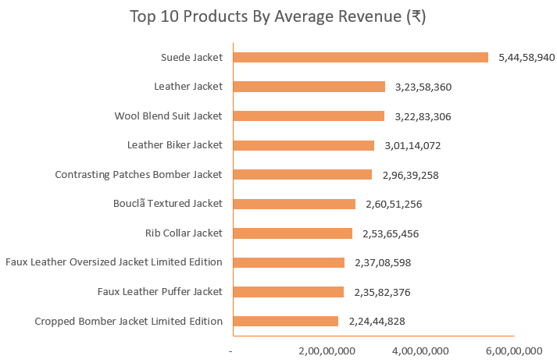
6) List down the top 10 products with the highest average revenue earned which are not seasonal.
Top 10 Products By Average Revenue
Suede Jacket
Leather Jacket
Wool Blend Suit Jacket
Leather Biker Jacket
Contrasting Patches Bomber Jacket
Boucla Textured Jacket
Rib Collar Jacket
Faux Leather Oversized Jacket
Faux Leather Puffer Jacket
Cropped Bomber Jacket Limited Edition

Slide 9
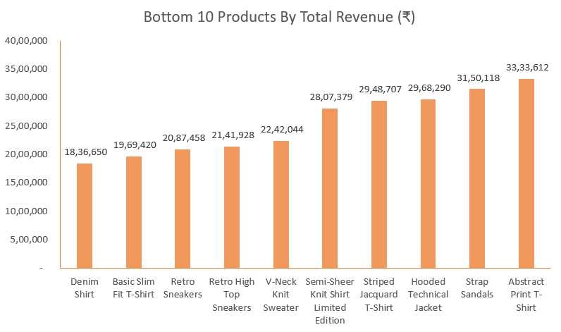
7) List down the bottom 10 products with the lowest revenue earned which are located at the aisle.
Bottom 10 Products By Total Revenue
Denim Shirt
Basic Slim Fit T-Shirt
Retro Sneakers
Retro High Top Sneakers
V-Neck Knit Sweater
Semi-Sheer Knit Shirt Limited Edition
Striped Jacquard T-Shirt
Hooded Technical Jacket
Strap Sandals
Abstract Print T-Shirt

Slide 10
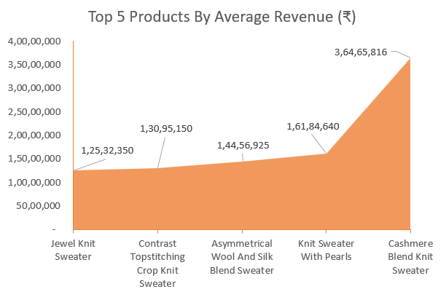
8) List down the top 5 products with highest average revenue for womens section.
Top 5 Products By Average Revenue
Jewel Knit Sweater
Contrast Topstitching Crop Knit Sweater
Asymmetrical Wool And Silk Blend Sweater
Knit Sweater With Pearls
Cashmere Blend Knit Sweater

Slide 11
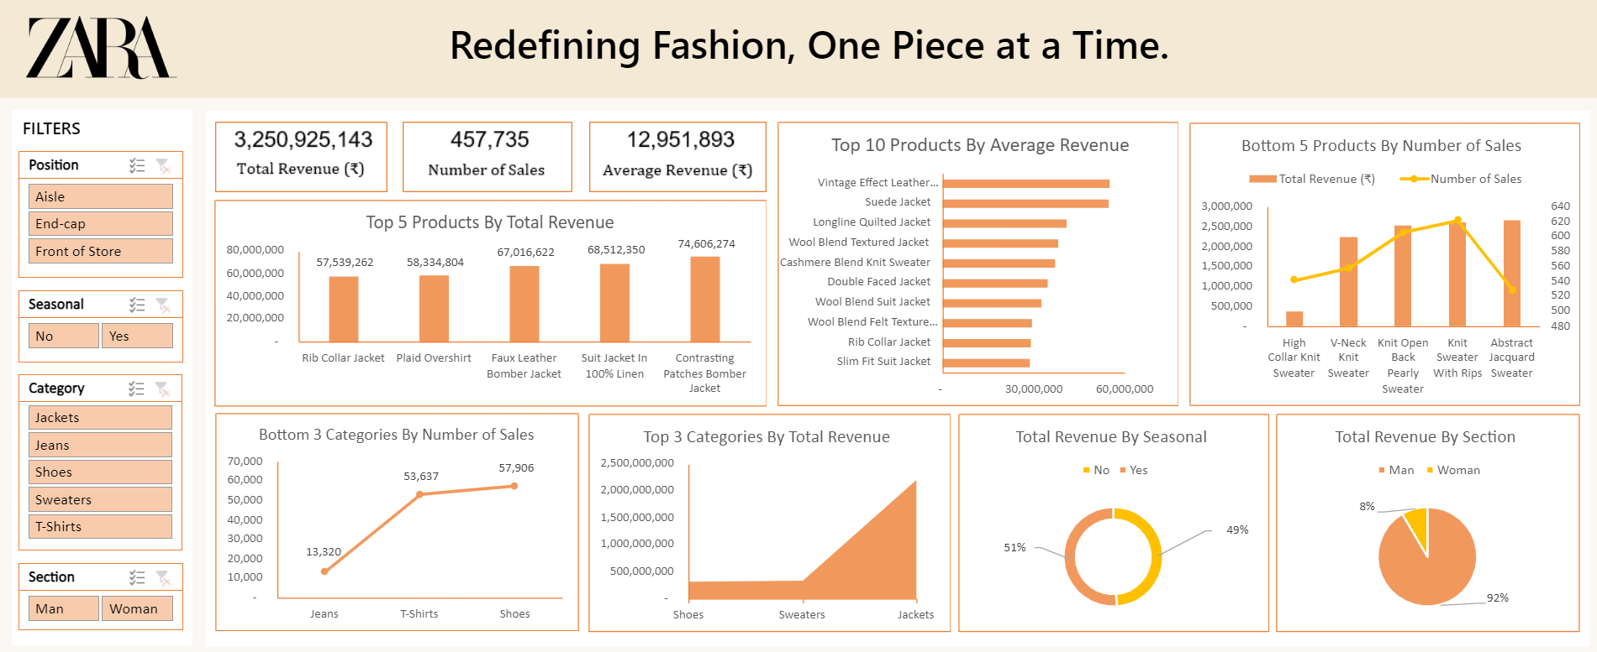
Dashboard

Slide 12

Thank You!
Elevate Your Everyday With Zara.

